Slide 1
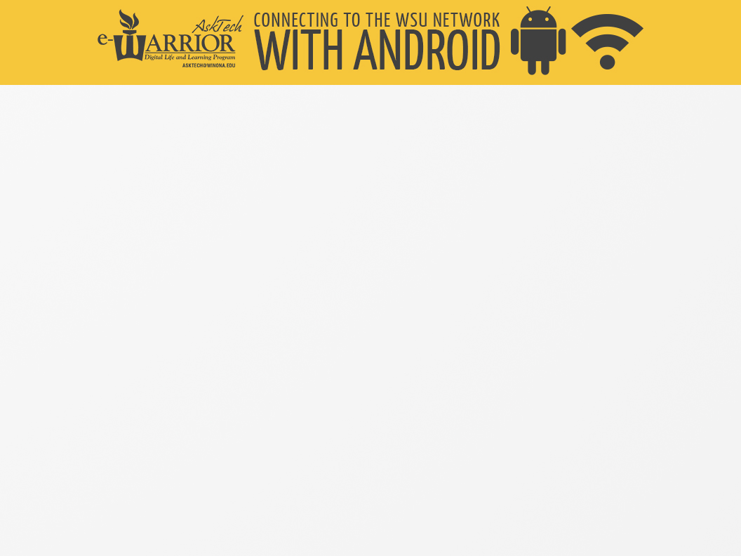
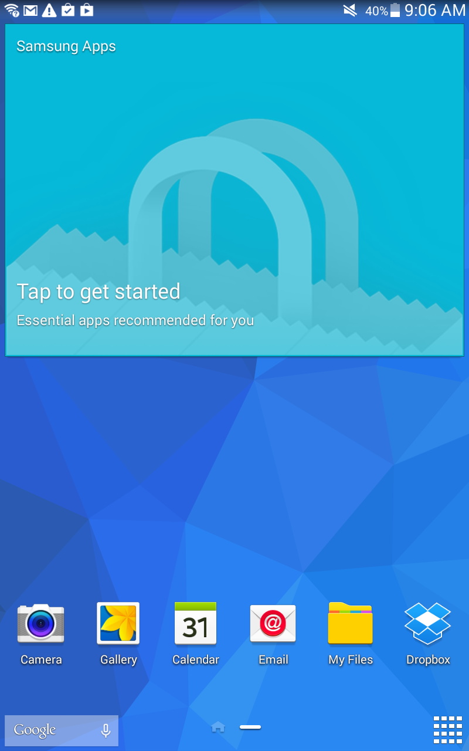
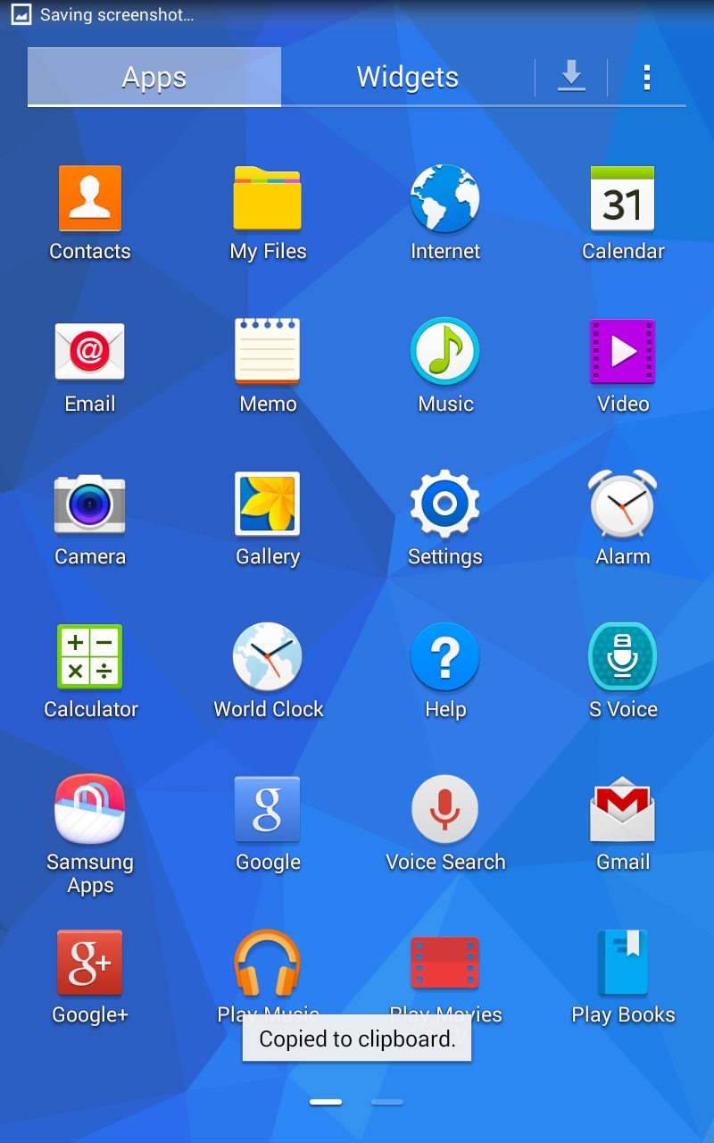
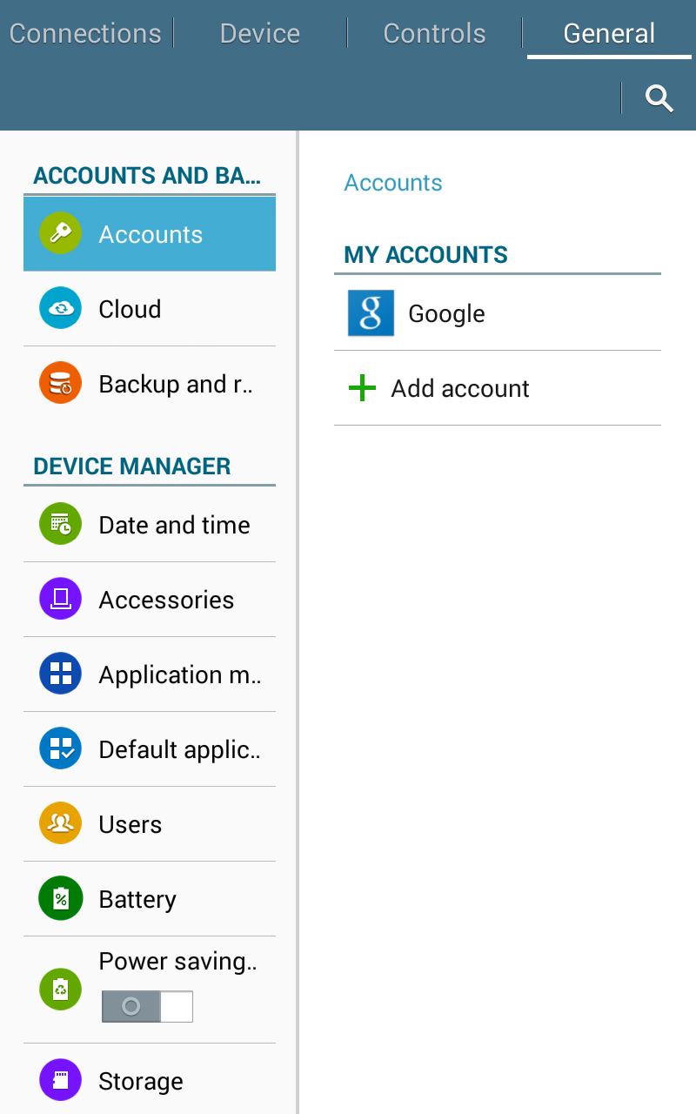
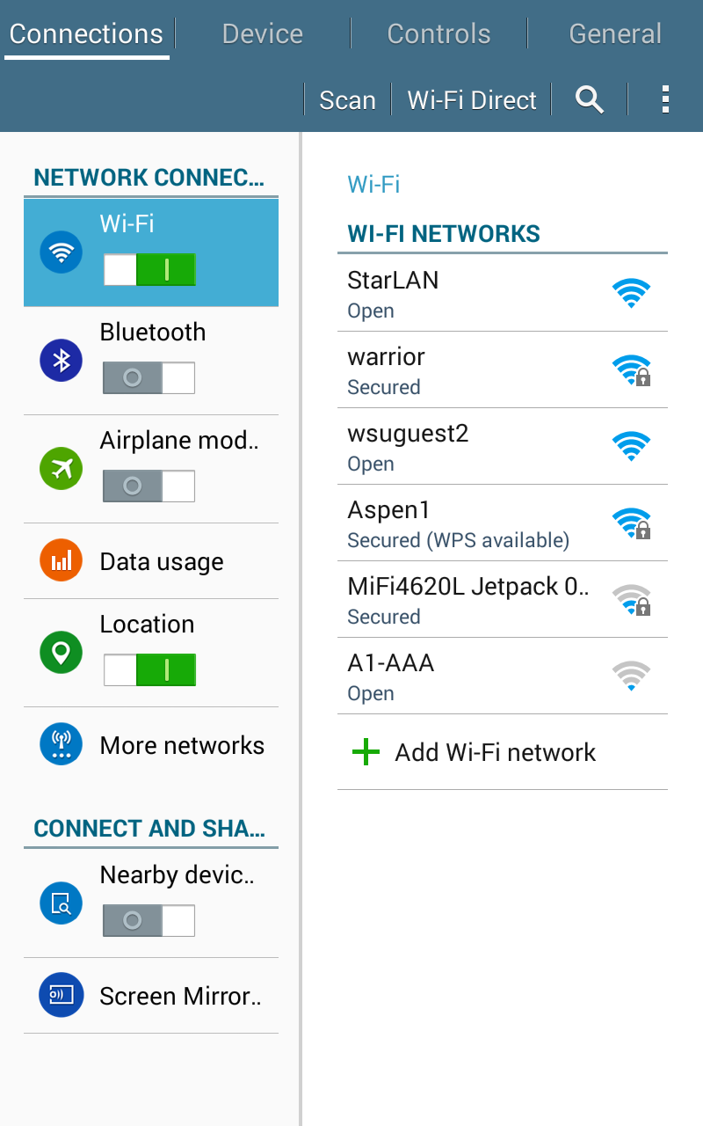
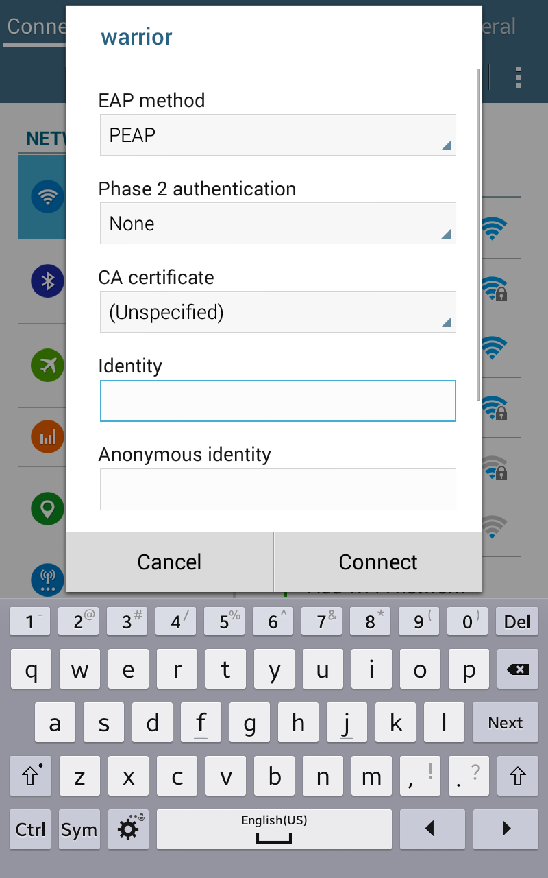
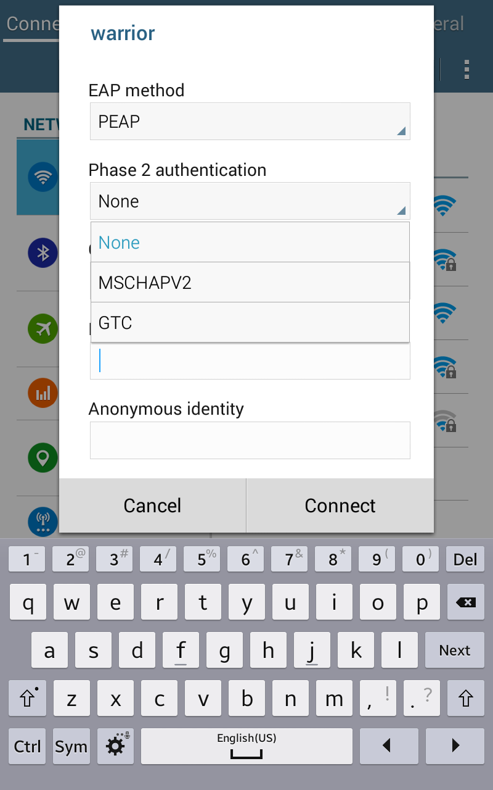
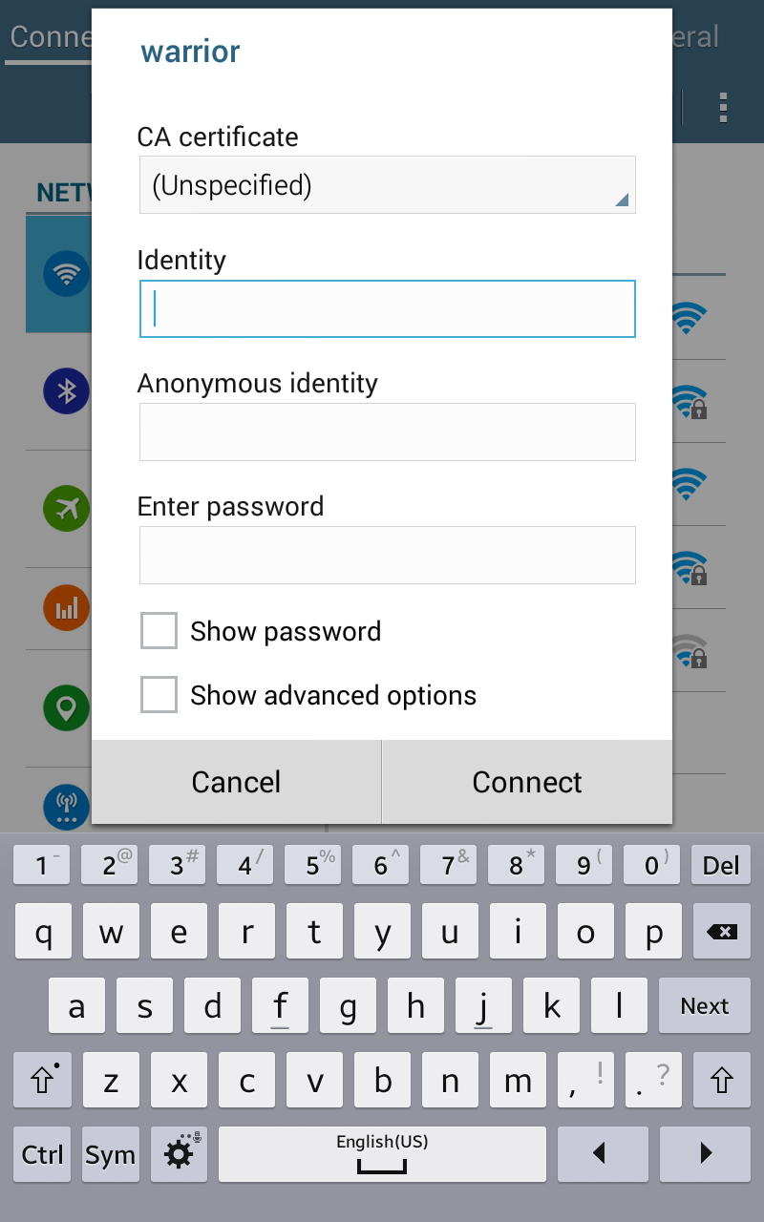
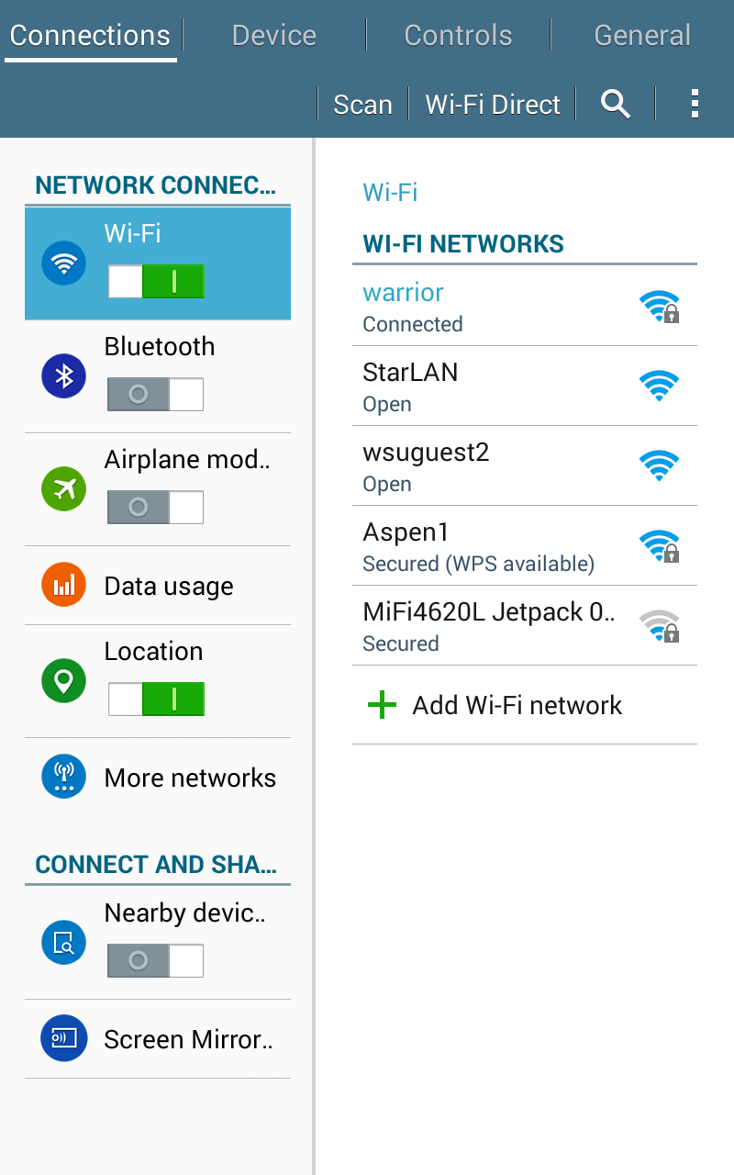
First tap the grid at the lower right-hand corner to bring up all your applications.
Then select “Settings” with the applications screen.
At the top-left corner tap “Connections.”
Be sure to check if Wi-Fi is enabled then then tap the “warrior” access point.
Under “Phase 2 authentication” tap the word “Non”.
Tap “MSCHAPV2” for authentication.
Enter your WSU Username and password.
Done! If you see “Connected” you are now on the WSU network.

